Slide 1

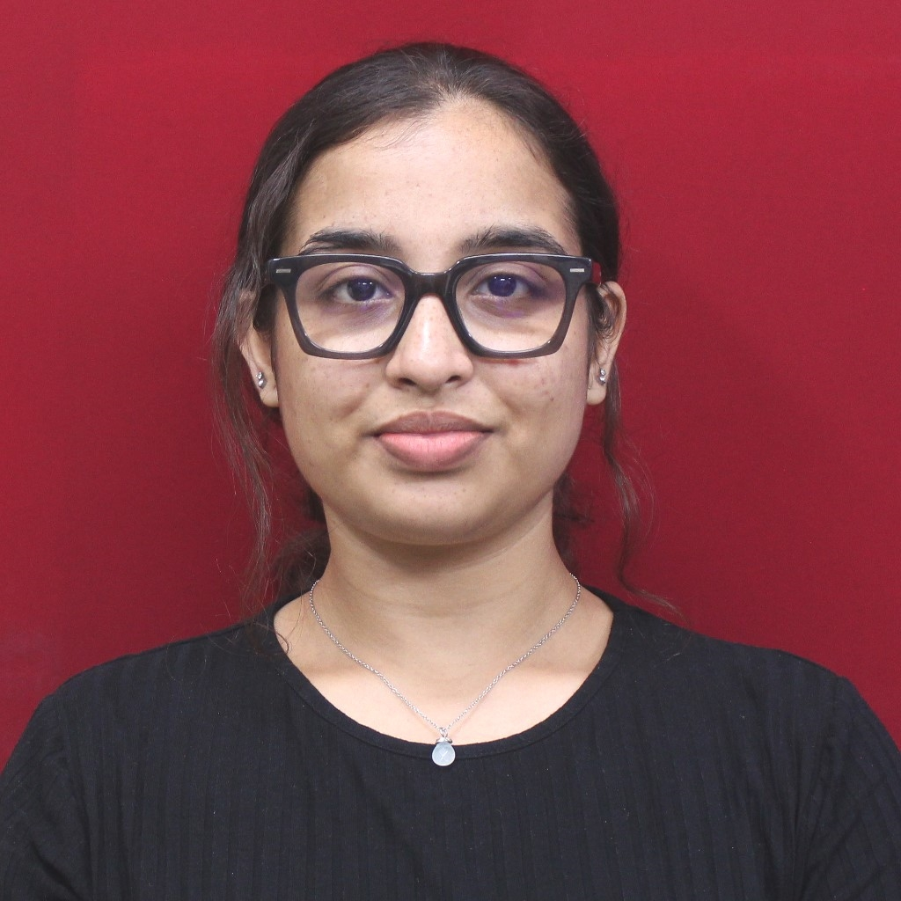
DEEP LEARNING BASED IMAGE INPAINTING AND DATASET CURATION FOR SATELLITE IMAGES
SRTD-RTCG-MISA
Name: Shikha Sheth
Designation: Student/Trainee
Institution: Charotar University of Science and Technology
Guide: SRI. ASHUTOSH GUPTA
(SCI/ENGR-SF ,SIPA-ODPG-HDPD)
ashutoshg@sac.isro.gov.in
PHOTO
MAJOR OBJECTIVES:
16 DEC 2024 to
09 APRIL 2025
METHODOLOGY FLOW CHART:
RESULTS/MAJOR FINDINGS:
i. File Path Management: The application provides a user-friendly interface for managing file paths, allowing users to easily view, modify, and validate directory locations.
ii. Configuration File Editing: The configuration file editing feature enables users to read, display, and edit configuration settings while enforcing data type validation to maintain data integrity.
iii. Dynamic Content Update: The application incorporates a dynamic content update mechanism that automatically reflects changes made to the underlying text files, eliminating the need for manual page refreshes.
iv. Disk Space Visualization: The disk space visualization feature offers a clear and intuitive representation of storage utilization through the use of donut charts, empowering users to make informed decisions about resource allocation.
v. Map Implementation: The map implementation leverages the Leaflet library to provide a visual aid for displaying spatial data and generating polygons based on mock function data.
vi. Dynamic Search: The dynamic search functionality enables real-time filtering and updating of displayed content based on user input, improving information retrieval efficiency and offering helpful spelling suggestions.
vii. Server Connectivity Check: The server connectivity check feature utilizes socket programming to verify the accessibility of specified servers and ports, providing clear output messages to aid in troubleshooting network issues.
viii. Image Formation Using Bin File: The application combines the power of NumPy and PIL libraries to generate images from binary files, allowing users to create and visualize images directly within the web application.
i. Requirements gathering: Crucial for understanding user needs and defining project scope.
ii. User interface design: Focuses on creating an intuitive and visually appealing user experience.
iii. Backend and frontend development: Separation of concerns allows for parallel development and easier maintenance.
iv. Integration: Ensures seamless communication between the backend and frontend components.
v. Testing: Comprehensive testing at various stages helps identify and fix issues early in the development cycle.
vi. Deployment: Enables users to access the web application.
CONCLUSION:
The web-based user interface project has successfully achieved its primary objective of developing an interactive platform for managing and scheduling satellite data processing tasks. By incorporating a range of features and functionalities, the application has streamlined the workflow and enhanced the overall efficiency of satellite data processing.

